Slide 1
Earth’s Resources Year 7 Science

Slide 2
Learning Objectives
Describe the differences between renewable and non-renewable resources.
Classify resources as renewable or non-renewable.
Classify renewable resources as continuous or non-continuous.
CFU 1
What are the two main types of resources that we will be learning about today?
Activate Prior Knowledge
Divide your whiteboard into two columns.
In the left column, list three things that humans use that will run out one day.
In the right column, list three things that humans use that will never run out.

Slide 3
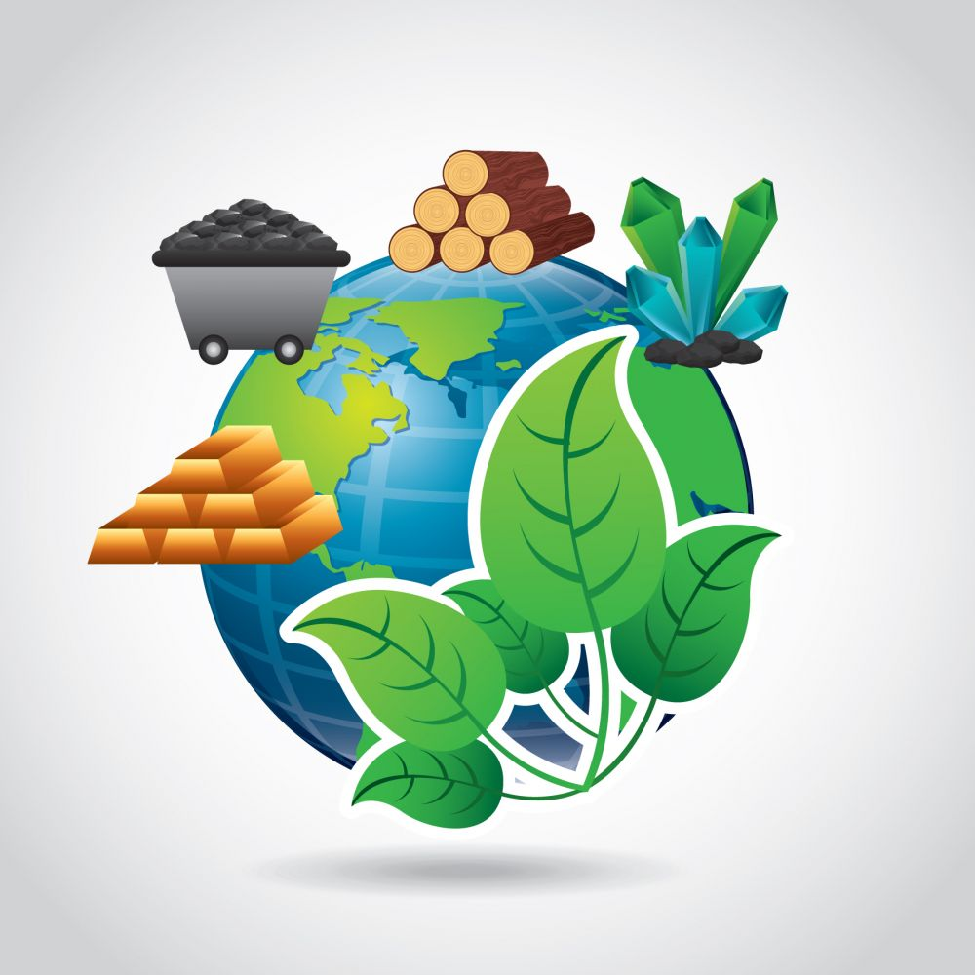
Concept Development
CFU 1
Think, Pair, Share: what are two characteristics of a resource?
Earth’s Resources
A resource is any naturally occurring thing that can be used to satisfy the needs of humans or other living things.
Resources can be classified into two major groups:
Renewable resources
Non-renewable resources
CFU 2
What are the two major groups of resources?
Vocabulary
resource (noun) a naturally occurring thing that can be used to satisfy a need

Slide 4
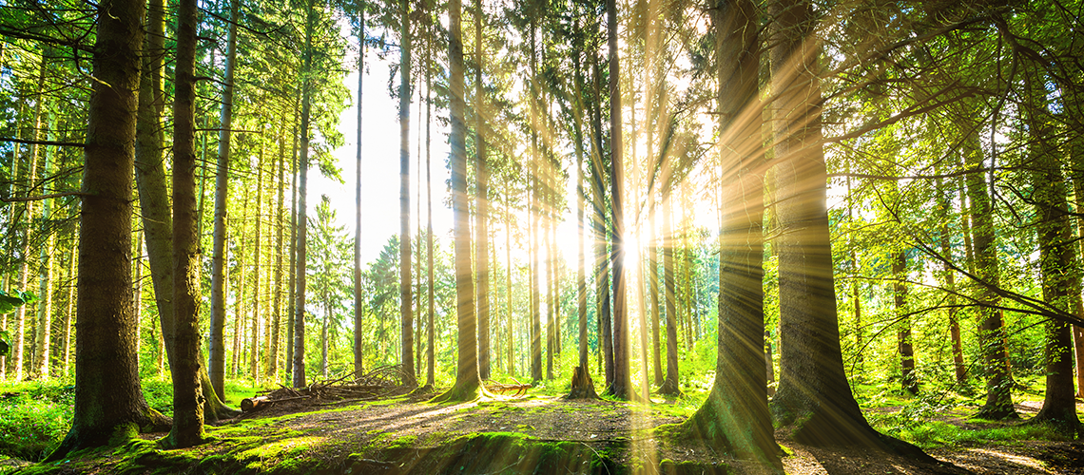
Concept Development
CFU 1
What are the two types of renewable resources?
Renewable Resources
There are two types of renewable resources:
Continuous renewable resources, which can never run out (e.g. sunlight, wind)
Non-continuous renewable resources, which can be used up but can come back over time (e.g. plants, trees)
CFU 2
What is the difference between continuous and non-continuous renewable resources?
CFU 3
Trees and forests are renewable resources. Are they continuous or non-continuous? Explain your answer.
Vocabulary
renewable (adjective) a natural resource that either cannot run out or can replenish itself when used

Slide 5
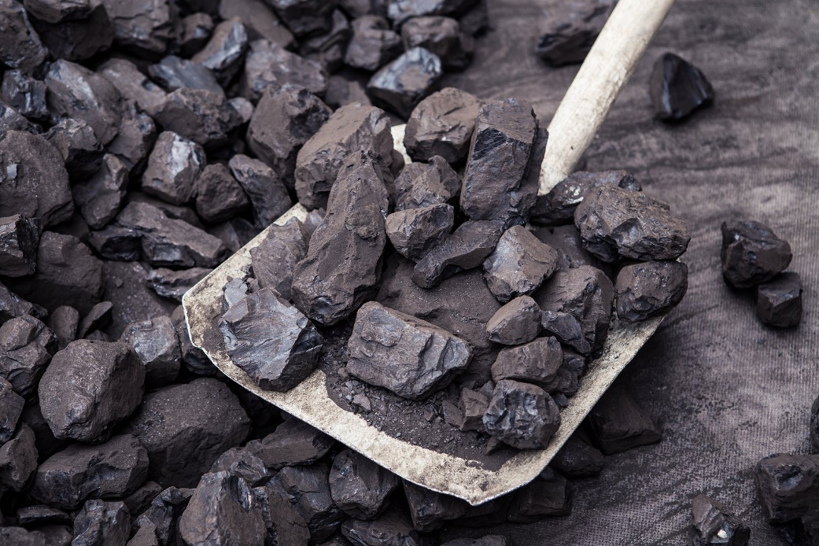
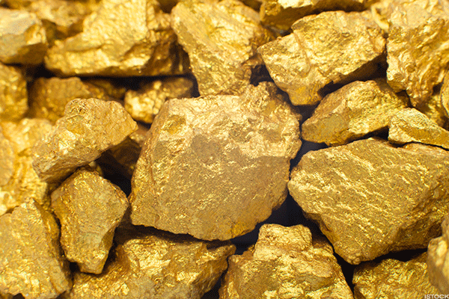
Concept Development
CFU 1
What are two characteristics of non-renewable resources?
Non-renewable Resources
Non-renewable resources can run out: only a limited amount of them is available.
They cannot come back after they have been used (or they take an extremely long time to come back).
Coal and oil are examples of non-renewable resources.
CFU 2
What does limited supply mean?
CFU 3
Is gold a renewable or non-renewable resource? Explain your choice.
Vocabulary
non-renewable (adjective) a natural resource that can be used up and does not replenish itself (or replenishes very slowly)

Slide 6
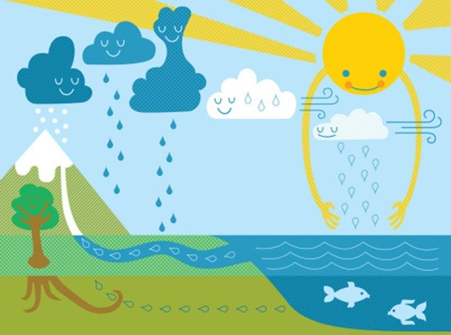
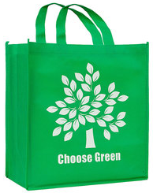
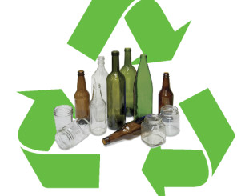
Concept Development
CFU 1
What is the difference between renewable and reusable?
Renewable, Reusable and Recyclable
These three terms are similar, but mean different things!
If something is renewable, it cannot run out (or can come back after being used)
If something is reusable, it can be used more than once (e.g. plastic bags / containers)
If something is recyclable, it can be made into something new (e.g. paper, bottles)
CFU 2
What is the difference between recyclable and renewable?
CFU 3
Think, Pair, Share: name one thing that is both reusable and recyclable.

Slide 7
Skill Development / Guided Practice
CFU 1
Which type of resource cannot be used up?
To tell the difference between continuous renewable, non-continuous renewable, and non-renewable resources, you need to ask two questions:
Can this resource run out?
No: continuous renewable
If it can run out, can it come back quickly?
Yes: non-continuous renewable
No: non-renewable
CFU 2
Which type of resource cannot come back within your lifetime?
Vocabulary
renewable (adjective) a natural resource that either cannot be used up or can replenish itself when used non-renewable (adjective) a natural resource that can be used up and does not replenish itself (or replenishes very slowly)

Slide 8

Skill Development / Guided Practice
Vocabulary
renewable (adjective) a natural resource that either cannot be used up or can replenish itself when used non-renewable (adjective) a natural resource that can be used up and does not replenish itself (or replenishes very slowly)
Can this resource run out?
No: continuous renewable
If it can run out, can it come back quickly?
Yes: non-continuous renewable
No: non-renewable
What type of resource is sunlight?
Sunlight cannot run out, so it is a continuous renewable resource.

Slide 9
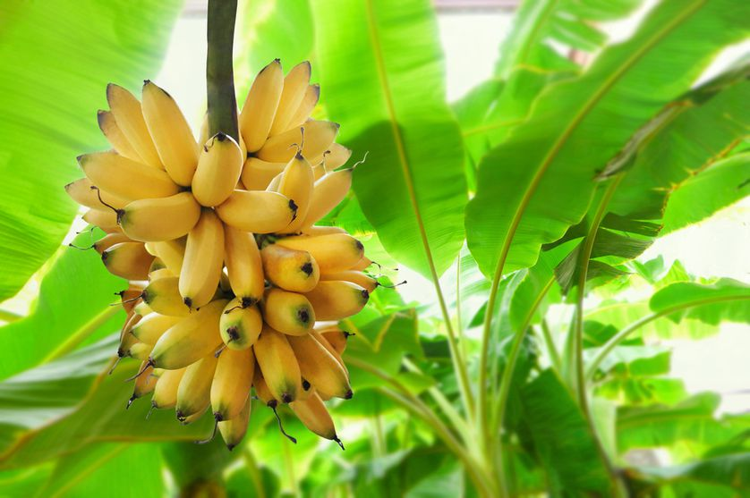
Skill Development / Guided Practice
Vocabulary
renewable (adjective) a natural resource that either cannot be used up or can replenish itself when used non-renewable (adjective) a natural resource that can be used up and does not replenish itself (or replenishes very slowly)
Can this resource run out?
No: continuous renewable
If it can run out, can it come back quickly?
Yes: non-continuous renewable
No: non-renewable
What type of resource are bananas?
Bananas can be used up, but can regrow quickly, so they are a non-continuous renewable resource.

Slide 10
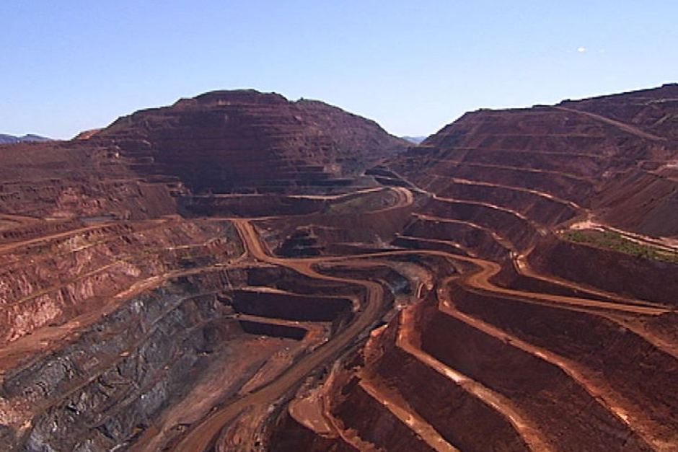
Skill Development / Guided Practice
Vocabulary
renewable (adjective) a natural resource that either cannot be used up or can replenish itself when used non-renewable (adjective) a natural resource that can be used up and does not replenish itself (or replenishes very slowly)
Can this resource run out?
No: continuous renewable
If it can run out, can it come back quickly?
Yes: non-continuous renewable
No: non-renewable
What type of resource is iron?
We will run out of iron one day, and it cannot come back, so it is a non-renewable resource.

Slide 11
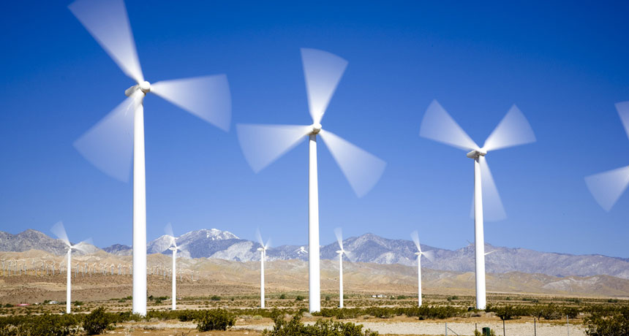
Skill Development / Guided Practice
Vocabulary
renewable (adjective) a natural resource that either cannot be used up or can replenish itself when used non-renewable (adjective) a natural resource that can be used up and does not replenish itself (or replenishes very slowly)
Can this resource run out?
No: continuous renewable
If it can run out, can it come back quickly?
Yes: non-continuous renewable
No: non-renewable
What type of resource is wind?
Wind cannot run out, so it is a continuous renewable resource.

Slide 12
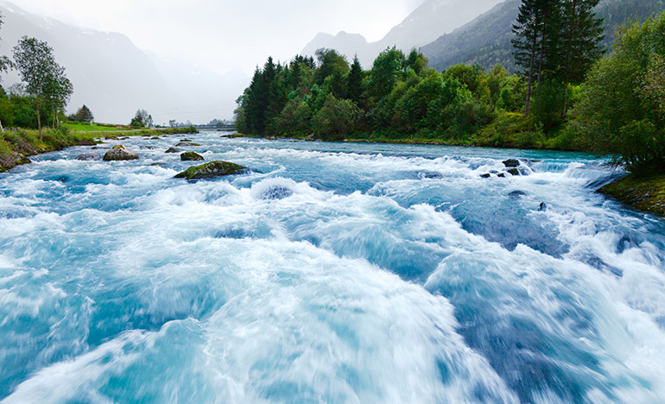
Skill Development / Guided Practice
Vocabulary
renewable (adjective) a natural resource that either cannot be used up or can replenish itself when used non-renewable (adjective) a natural resource that can be used up and does not replenish itself (or replenishes very slowly)
Can this resource run out?
No: continuous renewable
If it can run out, can it come back quickly?
Yes: non-continuous renewable
No: non-renewable
What type of resource is a river?
Most rivers flow constantly, so they are continuous renewable resources. However, some rivers only flow during certain times of year. These rivers could be considered non-continuous renewable resources.

Slide 13
Relevance
Humans rely on the natural resources of the Earth.
Oxygen and water are essential for keeping us alive.
Soil is necessary to grow our food.
Forests provide habitat for animals and timber for buildings.
Coal is used to produce electricity.
Gas is used for cooking and household heating.
However, a lot of these resources won’t be around forever – and we need to be ready for when they run out!

Slide 14
Skill Closure
Name two renewable and two non-renewable resources.
Skill Closure
Sunlight is a renewable resource. Is it continuous or non-continuous? Explain your choice.
Skill Closure
Wood can be used to provide heat for houses. Is it a renewable or non-renewable resource? Explain your response using a full sentence.

Slide 15
Independent Practice
Draw the table below in your book or on your device. Use Figure 4.1 on page 62-63 of the textbook to fill it out.
Answer questions 1-3 and 5 on page 63.
Continuous Renewable Resources | Non-continuous Renewable Resources | Non-renewable Resources

